Slide 1

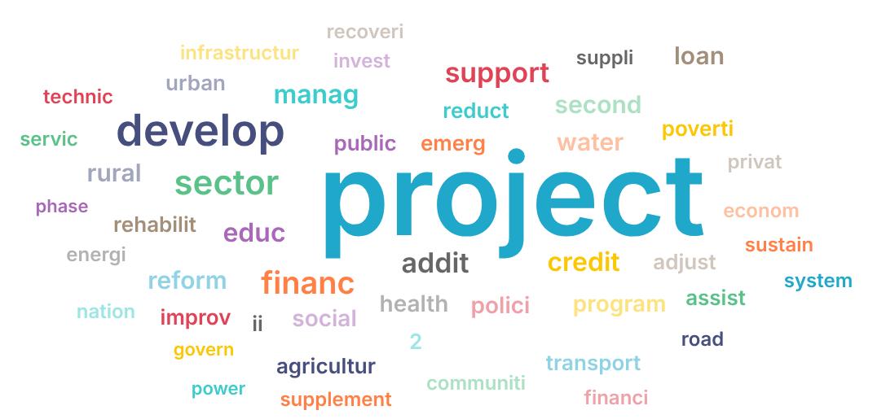
INVESTIGATIVE DATA STORY
The Illusion of Aid: Tracking the Global Donation Deficit
An in-depth analysis answering the critical question: Are global funds actually reaching their intended destinations?
Tariq Zeyad Jawad (Vili)
Data Engineer & Analyst

Slide 2
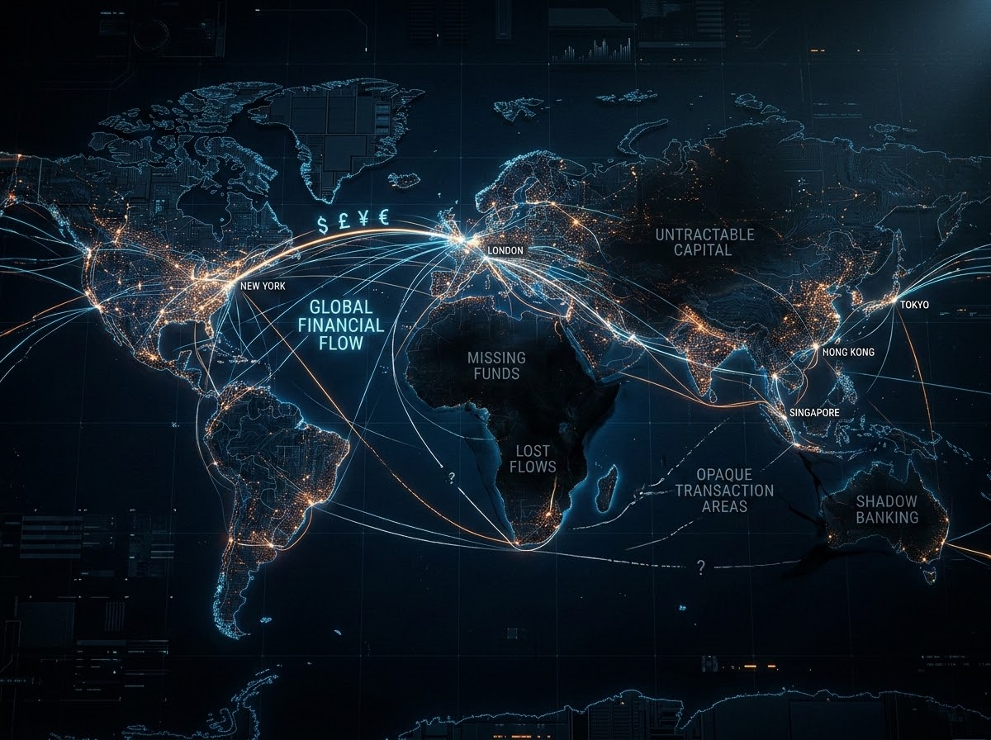
1. The $6 Billion Question
Every year, billions are pledged to global development and relief. But does the money actually reach the ground?
THE INVESTIGATION
By auditing global financial commitments against actual disbursements and geospatial transactions, we uncover a disturbing reality about where the money stops.

Slide 3
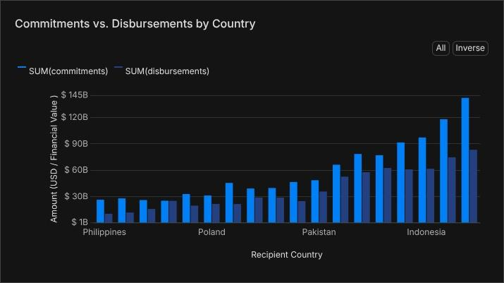
2. Massive Pledges, Minimal Execution
$6.22B
Total Commitments
$1.23M
Actual Disbursements
The data reveals a staggering deficit. We tracked $6.22 Billion in Total Financial Commitments, yet Total Actual Disbursements stand at a mere $1.23 Million.
The Evidence: The 'Commitments vs. Disbursements by Country' chart illustrates this chasm. Nations are promised massive infrastructure and aid, but the actual monetary flow is severely bottlenecked before reaching the recipient countries.

Slide 4
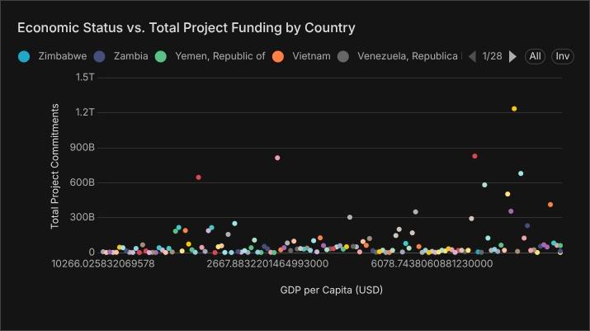
3. Is the Money Following the Need?
If funds are scarce, are they at least reaching the poorest nations?
ECONOMIC STATUS VS. TOTAL PROJECT FUNDING
THE EVIDENCE
The 'Economic Status vs. Total Project Funding' scatter plot reveals a scattered, illogical distribution.
Massive project commitments are frequently allocated regardless of the actual GDP per capita of the recipient country, indicating that funding decisions are often driven by factors other than pure economic need.

Slide 5
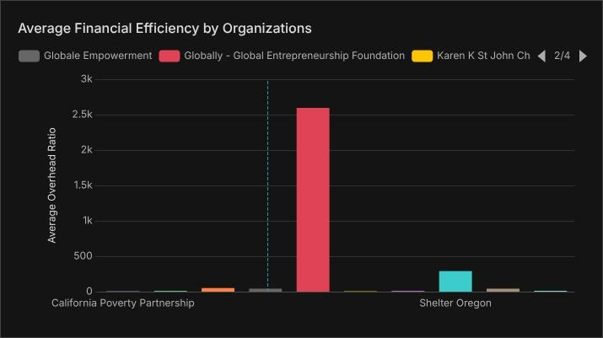
4. Where is the Money Actually Going?
The funds aren't just delayed; they are being absorbed by intermediaries.
The Top High-Risk Sector is 'Government and civil society' with a massive risk score of 37.4k.
THE EVIDENCE
Look at the 'Average Financial Efficiency' chart. The towering red bar exposes organizations operating with astronomical administrative overhead ratios. Millions are evaporating into operational costs rather than executing the promised projects.

Slide 6
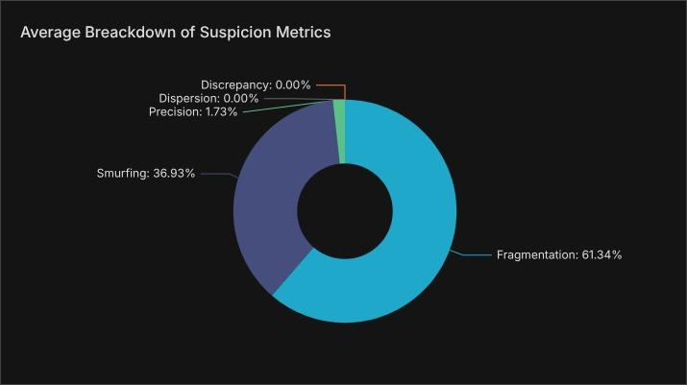
5. How Are These Inefficiencies Hidden?
With 38.91% of all projects flagged as suspicious, the system is being actively gamed.
THE EVIDENCE
61.34% Fragmentation: Splitting funds across confusing, multi-sector categories to obscure tracking.
36.93% Smurfing: Breaking large funds into micro-transactions to fly under audit radars.
The Word Cloud supports this: vague terms like 'project' and 'develop' dominate, lacking specific, trackable deliverables.

Slide 7
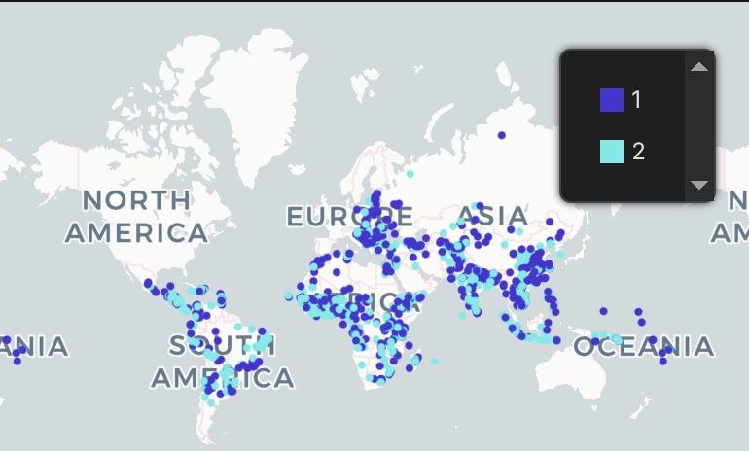
6. The Spatial Reality of Risk
True aid requires on-the-ground physical execution.
GEOGRAPHICAL DISTRIBUTION BY RISK LEVELS
THE EVIDENCE
The 'Geographical Distribution by Risk Levels' map shows high-risk transactions clustering in specific global pockets.
This spatial density proves that risk isn't a random data error; it's a systemic pattern concentrated in regions where financial oversight is severely compromised.

Slide 8
7. Securing the Future of Global Aid
VERDICT
The money is not reliably reaching its intended destination.
It is bottlenecked at the commitment phase, absorbed by organizational overhead, and obscured through financial fragmentation.
RECOMMENDATIONS
01
Cap Administrative Overhead
Enforce a strict maximum overhead ratio for all civil society partners.
02
Milestone-Based Disbursements
Shift from bulk commitments to micro-releases tied strictly to verified, geolocated milestones.
03
Algorithmic Auditing
Deploy this exact risk-scoring engine to flag 'Smurfing' and 'Fragmentation' before funds are approved.

